Slide 1
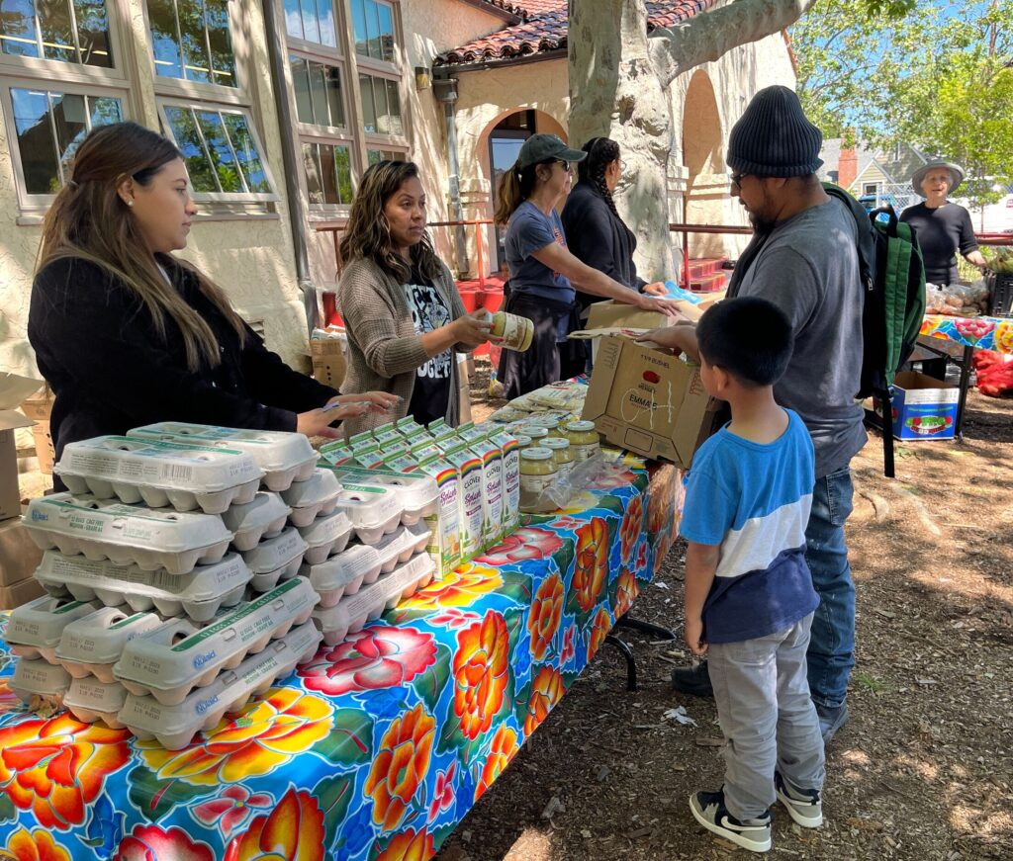
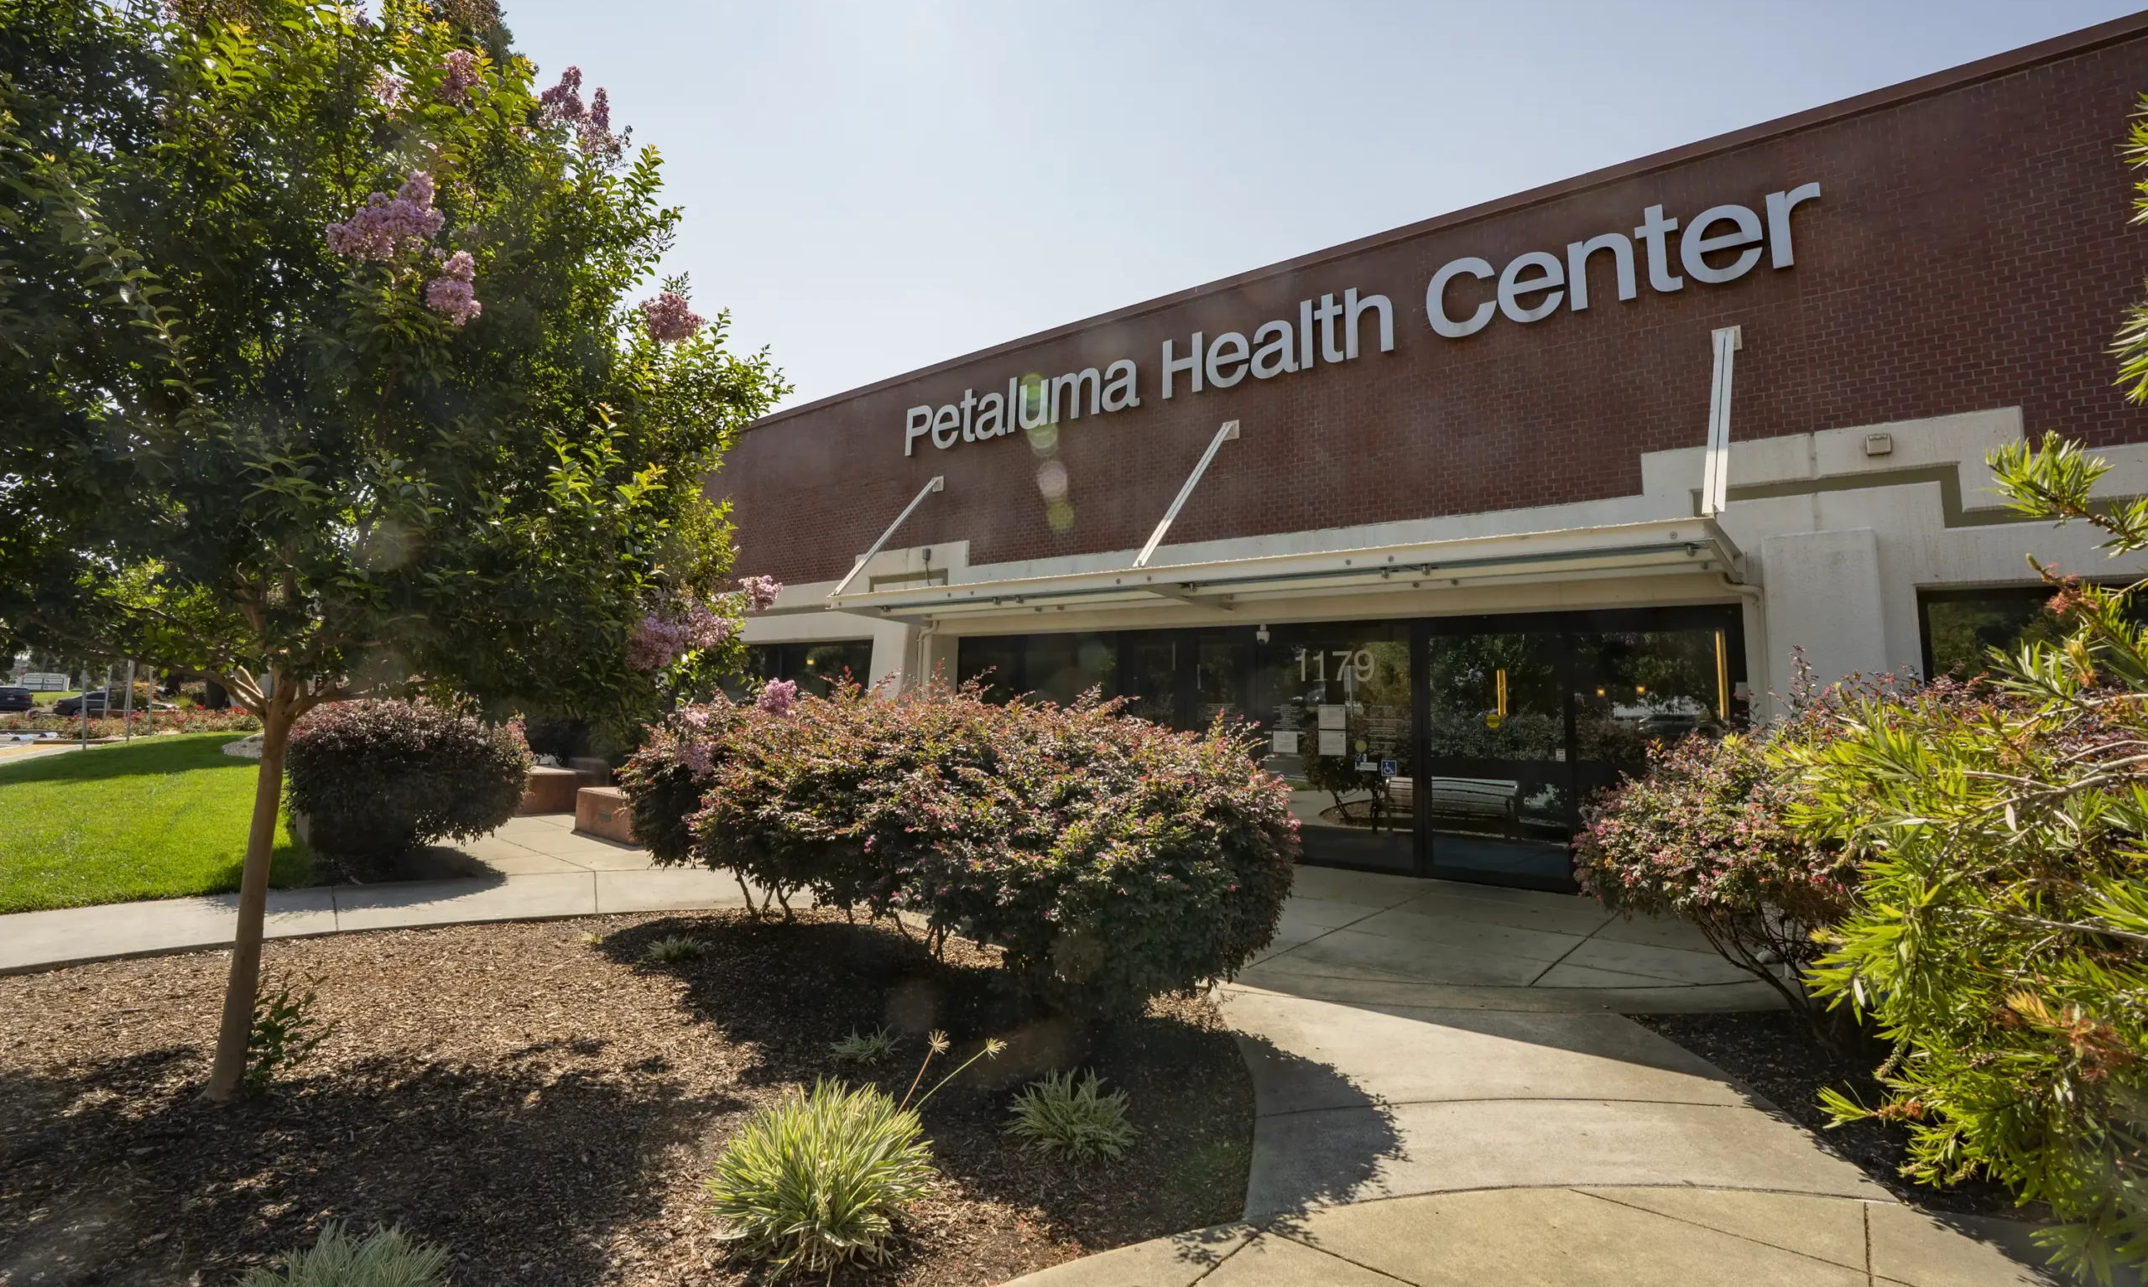

County of Sonoma
Federal H.R. 1 Impacts
SCMCA – May 14, 2026
Jennifer Solito, Assistant County Executive

Slide 2
Agenda
Overview of H.R. 1
Medi-Cal & Indigent Healthcare Impacts
CalFresh/Food Insecurity Impacts
Potential County Mitigation Strategies
Notes:
House Resolution 1 (H.R. 1) was signed into law on July 4, 2025, is a sweeping tax and fiscal legislation that makes permanent key tax cuts, expands deductions and credits, and restructures certain federal programs.
Impacts will be seen in:
Health care coverage & financing
Food Assistance
Higher Education
Personal and Corporation Taxes
Clean Energy and Electric Vehicles
County services and operations will be impacted regarding:
Health care coverage (Medi-Cal and Medically-Indigent coverage)
Food Assistance coverage and financing (Supplemental Nutrition Assistance Program (SNAP)/CalFresh)

Slide 3
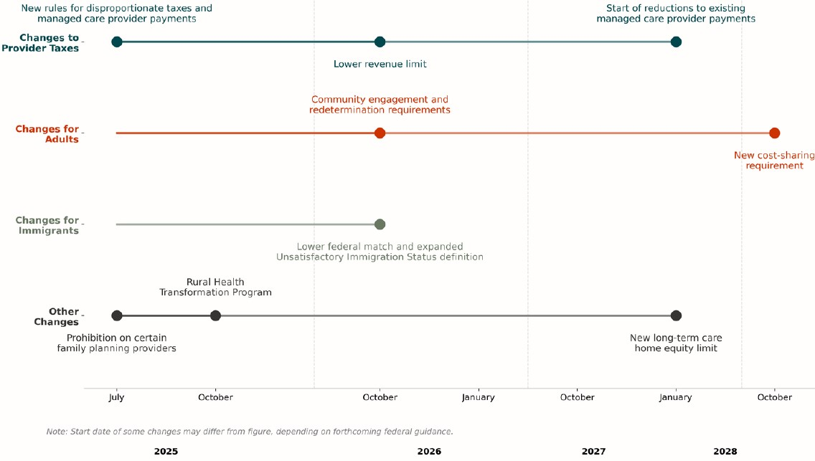
Implementation Timeline
Notes:
This somewhat hard to read slide is a high-level of summary of when the key provisions take place. The takeaway here is that most provisions do not take effect until late 2026 through 2028. And although this gives us some time to prepare, the staggered and chaotic roll out still has gaps, with some federal guidance still incomplete, and the State’s response to support counties and programs is still unknown.

Slide 4
IMPACT – HEALTH CARE COVERAGE
Topic | Description | Starting Date
Adults in Medi-Cal
Community Engagement | Requires most able-bodied adults to work, study, or complete community service | January 2027
Redetermination Frequency | Increased frequency of eligibility redeterminations for childless adults | January 2027
Cost Sharing | Requires state to impose cost-sharing on higher-income childless adults | October 2028
People with Unsatisfactory Immigration Status in Medi-Cal
Medicaid eligibility | Narrows eligibility for noncitizens | October 2026
Federal match | Reduces federal match on emergency services | October 2026
People in Covered California
Premium tax credits | Narrows eligibility for noncitizens | January 2027
Automatic re-enrollment | Eliminates automatic re-enrollment for premium and cost-sharing subsidies | January 2028
Notes:
This slide provides more details about what changes take place when.
A few key impacts here I want to highlight:
-Beginning January 2027, H.R. 1 requires most able-bodied, childless adults, with certain exceptions, to complete at least 80 hours per month of work, education, or community service.
-Also, in January 2027 the increased frequency of redetermination for eligibility begins, which requires redeterminations every 6 months, versus the current annual renewal process.
-And in October 2026, you see reduced eligibility and coverage for the non-citizen community.
One note I also want to make, which is relevant to the mitigation strategies you see later in the presentation, is that research from prior Medicaid work requirement pilots have shown that most people who lose coverage do so due to administrative barriers, not refusal to work. This is fundamentally an administrative churn issue, both for the beneficiary in completing their paperwork requirements accurately, and in the ability of counties to process and assist applicants.
One last thing to note, counties are the only entity that are able to process applications for eligibility. Other entities, such as clinics, external case supports, etc. can assist clients in completing the forms and applications, but only County personnel are able to have access to the State’s systems required to process applications, so this burden lies soley with the County.

Slide 5
Anticipated Sonoma County Impacts
H.R. 1 changes eligibility requirements for Medi-Cal:
  Increased work requirements
  Increased eligibility redetermination frequency (6 months vs annually)
  Narrowed eligibility for noncitizens
Expect 9,000 – 25,000 residents to lose Medi-Cal*
Notes:
This slide outlines the expected impacts specific to Medi-Cal coverage in Sonoma County.
Currently, we have 132,000 residents enrolled in Medi-Cal. We expect between 7% to 20%, or approximately 9,000 to 26,500, of those to be impacted by H.R. 1 eligibility changes.
Specifically, we expect about 8,700 to lose coverage based on the work requirements; 12,000 based on renewal process challenges, and 4,400 based on Unsatisfactory Immigration Status, or UIS.
Specifically related to the UIS population, we currently have 22,000 individuals with UIS enrolled in full-scope Medi-Cal. We expect 4,400 to be discontinued due to not successfully completing renewal processes. If they lose coverage, they can reapply, will be eligible for restricted scope Medi-Cal only.
As you can see from the figures, the impact driver is not eligibility, it is the ability to successfully navigate a more complex system to maintain coverage.

Slide 6
Waterfall of Medical Coverage
Medi-Cal Enrolled
Meet eligibility Requirements
CMSP Enrolled
Meet CMSP requirements
Medically Indigent
Receive "subsistence medical care" at qualifying provider
Meet renewal requirements
If not, may meet CMSP Requirements
If not, may meet indigent care requirements
Reapply every six months
For UIS, may be enrolled in restricted-scope Medi-Cal

Slide 7
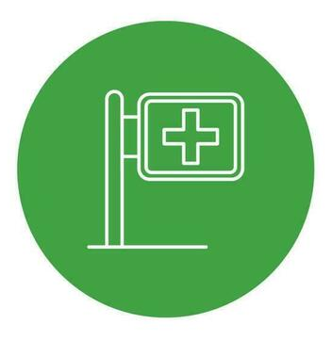
County Responsibility – Indigent Care
Welfare and Institutions Code (WIC) Section 17000:
  "Every county and every city and county shall relieve and support all incompetent, poor, indigent persons, and those incapacitated by age, disease, or accident, lawfully resident therein, when such persons are not supported and relieved by their relatives and friends, by their own means, or by state hospitals or other state or private institutions.“
Notes:
This slides defines Welfare and Institutions Code, or WIC, Section 17,000, which outlines that counties are legally required to provide basic health care as a last resort to indigent persons. It’s designed to ensure that low-income residents who are not eligible for health coverage programs like Medi-Cal and Covered California have access to meet life-saving health care needs.
17,000 requires that counties provide for, at a minimum, medical services necessary for the treatment of acute life-and-limb threatening conditions and emergency medical services, and those that are sufficient to remedy substantial pain and infection. It is not health insurance, and does not provide the same level of benefits available through Medi-Cal or the ACA. It provides only the services necessary to prevent serious harm, pain, or infection.
Historically, after the implementation of the ACA the majority of medically indigent individuals were covered through Medi-Cal or Covered California, greatly reducing County’s role. So this has not been a requirement that counties, including ours, have had to consider in over a decade.
The take away here is that when health insurance coverage is lost, the standard of care drops significantly, and responsibility shifts to the County.
-Reduction in BH service access.
-Downstream insurance/hospital impacts:
And more broadly, whole person care is reduced. More people will become uninsured. As a result, primary and specialty care access decreased. Chronic diseases go unmanaged. Care shifts to Community Health Clinics and Emergency Departments, resulting in increase impact to local hospital through uncompensated care, and a cycle of poorly managed health conditions that become bigger impacts downstream. Increased un-compensated care for uninsured patients are expected to result in higher health insurance rates for employers, including us.
The takeaway here is the movement from an upstream, preventative care system, to a down-stream, crisis-driven system of care.

Slide 8

County Medical Services Program
Concern: Scalability of County Medial Service Providers (CMSP)
Due to H.R. 1 changes, CMSP estimates that up to 11,560 individuals in Sonoma County will be eligible for their coverage.
The full costs of services to these individuals would be $102,490,960/yr to the County, based on current services and costs.
Known-Unknown: CMSP amending their program to reduce services provided and limit eligibility = less individuals with coverage, but reduced costs.
State currently provides no funding to CMSP = Legislative Advocacy Opportunity!

Slide 9

Indigent Care through Local CHCs
Need: Support Community Health Center (CHC) network
The network of CHCs in the county are anticipating 14,677 more individuals (a 95% increase) will attend their clinics without any medical coverage.
Requesting $12.8 million in FY 26/27 to support this increased need and provide service for County’s WIC 17000 indigent care obligation.
Notes:
So if you think back to the waterfall slide, of folks that don’t have private health insurance or coverage through the ACA, they move to Medi-Cal. When they are not eligible for Medi-Cal, then step down into CMSP. Lastly, when they don’t qualify for CMSP, they are in the medically indigent group with no health care coverage or insurance, and the County maintains responsibly for minimal, life-and-limb coverage.
In the past, the County ran a hospital to meet it’s indigent healthcare obligation. Then the County sold the hospital, and this obligation was largely addressed through the ACA.
So now we are in a place of having to determine how to meet this need. The main models for non-hospital counties is to meet this need through implementing a managed care plan, which has extremely high cost and administrative burden, in addition to the time to set up such a plan in-house. As such, staff does not recommend this approach.
Instead, we recommend providing funding to the local community health clinic network. CHCs provide primary care services to individuals regardless of their ability to pay and to those without health coverage.
We have been meeting with Aliados, representing our 8 local CHCs to understand the expected impacts to the system. The local CHCs expect just under 15,000 additional individuals to seek service in the clinics. Based on their cost per indigent patient, it is estimated to impact the system at $12.8 million this next FY, and staff recommends providing this funding to manage the County’s obligation.

Slide 10
IMPACT – FOOD ASSISTANCE
Topic | Description | Starting Date
CalFresh eligibility | Expands work requirements for able-bodied adults with dependents | Immediate, pending federal guidance
CalFresh eligibility | Limits eligibility for noncitizens | Immediate, pending federal guidance
CalFresh eligibility | Limits allowable utility and internet deductions | Immediate, pending federal guidance
Administrative Cost Share | Increases state and county shares of administrative costs | October 2026
Benefit Cost Share | Increases state share of benefits costs | October 2027, depending on error rate
Notes:
Now we’ll shift to the food security side of the impacts of HR.1.
This slide outlines the changes to CalFresh eligibility and dates of implementation. Overall, the changes are very similar to those to Medi-Cal, but differ slightly in the specific eligibility terms and changes, as well as implementation dates. Again, chaos by design.
The one new element to note here is the increase in the Administrative Cost Share, which represents a reduction in the amount the federal government will contribute to administering these programs. You’ll hear more about this in the next few slides.
CalFresh is federally mandated and in California, is state-supervised and county-operated. Counties are responsible for eligibility determination and enrollment.
Unlike indigent health coverage, the county does not have statutory responsibility to meet a minimum level of food provision.

Slide 11
Anticipated Sonoma County Impacts
H.R. 1 changes eligibility requirements for Medi-Cal:
  Increased work requirements
  Increased eligibility redetermination frequency
  Narrowed eligibility for noncitizens
  Increases County’s share of Administrative Costs
Expect 4,700 residents to lose CalFresh*
Total benefits lost: $1,440,000 monthly
Notes:
Supplemental Nutrition Assistance Program, or SNAP, is a federally mandated program that provides monthly food benefits to individuals and families with low-income. SNAP is administered at the state level and in California is known as CalFresh. As discussed previously, counties are responsible for eligibility determination and enrollment, and this cannot be subcontracted out to a non-county entity. Counties are not responsible for direct food provision, only for eligibility determinations and enrollment.
Currently, 42,700 Sonoma County residents are enrolled in CalFresh, living in 27,400 households. Of the 13,000 estimated to be subject to work requirements, approximately 30%, or 3,900 are estimated to not meet those requirements. Additionally, 762 noncitizens are expected to lose coverage next FY.
These loses of coverage total approximately $1.4 million in monthly benefits, or $17.3 million annually.

Slide 12

Potential Mitigation Strategies
Consideration: Support robust and responsive food distribution system
For example, as a result of loses of CalFresh benefits, the Redwood Empire Food Bank anticipates and increased annual need of $2.6 to $5 million, adding 150,000 more meals per year to their distribution.
County to Host Food Convening to inventory what services are offered across the county, and identify gaps and resource needs.
Evaluating County General Assistance Program (no state/federal funding provided)

Slide 13
Resources Needed - Staffing
FTEs | Position | Time Period | Request
38.0 FTE | Dual-Fill & Time-Limited Eligibility staff (3-year total: $18,419,400) | Dual-Fill & Time-Limited | FY 26-27: $5,744,600 FY 27-28: $6,244,400 FY 28-20: $6,430,400
7.0 FTE | Work Requirement Case Managers (3-year total: $3,963,300) | Time-Limited | FY 26-27: $1,236,200 FY 27-28: $1,343,200 FY 28-20: $1,383,900
4.0 FTE | General Assistance Case Managers | Ongoing | FY 26-27: $470,700 FY 27-28: $484,800 FY 28-29: $499,500
 | No entry | Staffing Subtotal | $23,837,700
 |  | FY 26-27 Total | $7,451,500
 |  | FY 27-28 Total | $8,072,400
 |  | FY 28-29 Total | $8,313,800
Notes:
-explain 3 year, one-time funding recommendations
-real vs. not real figures

Slide 14
Resources Needed – Partners & Programs
Focus | Recurrence | Request
Community Health Clinic Funding | Annual | $12,800,000
Food System Support* | Annual | $1,000,000
Optional: General Assistance Award Increase (maximum increase allowed) | Annual | $676,800
CMSP Program Costs – Maximum-As-Is | Annual | $102,490,960
No entry | Partners & Programs Subtotal | $116,967,760
No entry | FY 26-27 Maximum | $124,419,260
 | FY 27-28 Maximum | $125,040,160
 | FY 28-29 Maximum | $125,281,560
*Placeholder - Amount to be determined following Food Convening
Notes:
-real vs non-real figures

Slide 15
Next Steps
Indigent Health Care
Continue discussions with Aliados and CHCs
Track CMSP program changes
Track State Budget
CalFresh
Host Food Convening in Summer 2026
County Budget
Return to the Board in June budget hearings to recommend specific funding and sources
Board may want to consider delaying significant FY 26-27 budget decisions until the fall, following final State budget and other cost determinations

Slide 16
Questions?

