Slide 1


Providing Support for
Foster & Homeless Youth
Joanna Paun, MA, PPSC
Foster & Homeless Youth Education Services Coordinator
(707) 524-2661 ~ jpaun@scoe.org

Slide 2
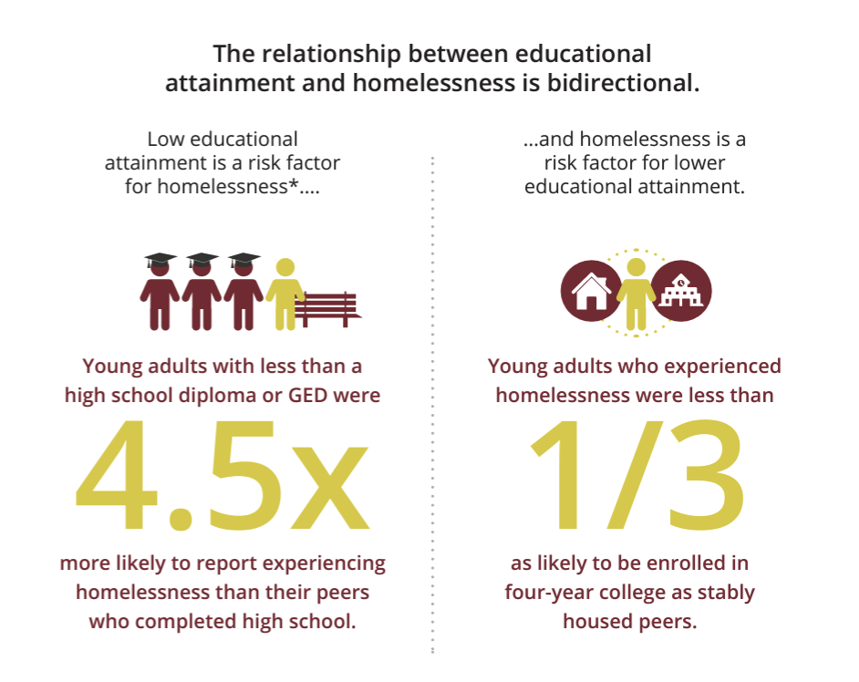
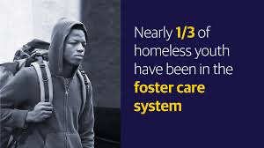
Leading with empathy
Foster Youth
A child or youth who has been removed from their home, is a dependent-victim of abuse or neglect, a juvenile who has violated the law
Homeless students
Children and youth who lack a fixed, regular,
and adequate nighttime residence.

Slide 3
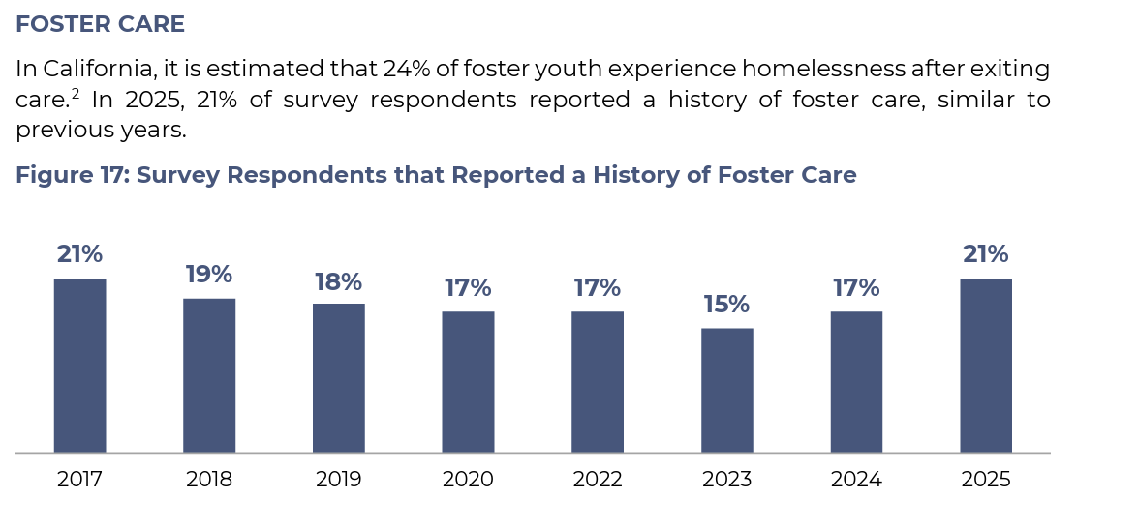
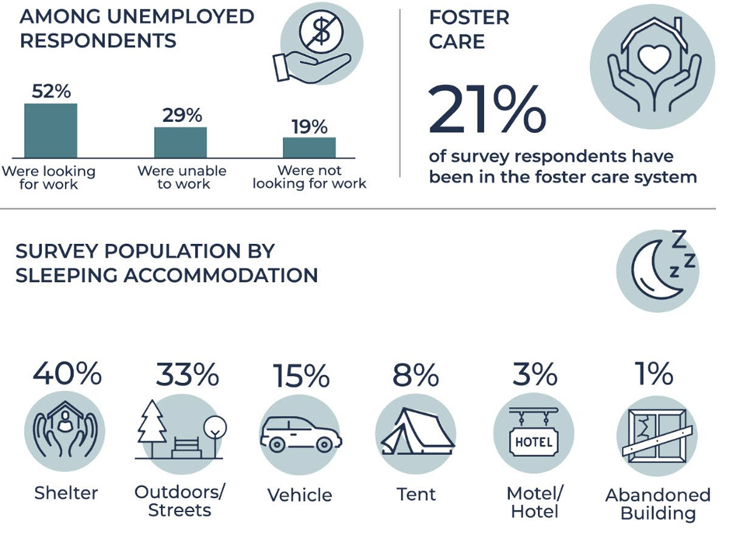
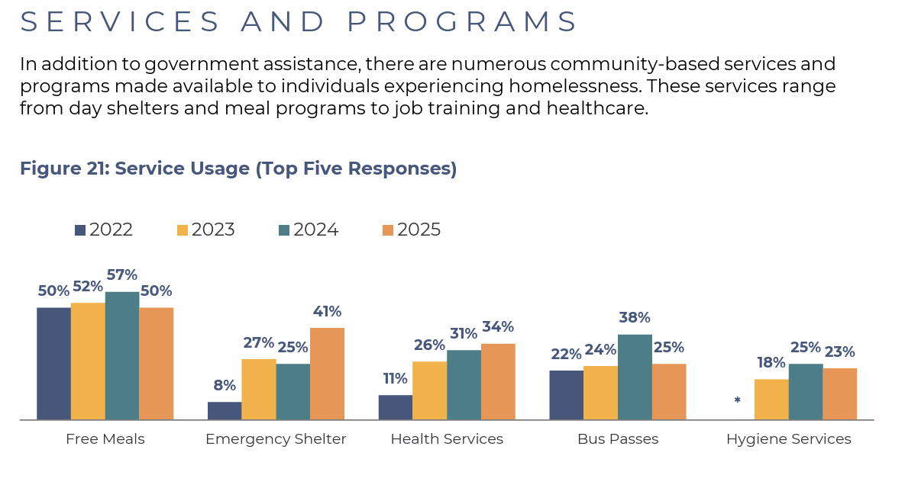
From the 2025 Sonoma County Point-in-Time Count
Notes:
-What happens to one group affects all of us. These are children in you towns and cities. Missing is education; -Effects the bottom line of your local economy (parents, teachers, students)
People who have been in the foster care system are also more likely than others to experience homelessness

Slide 4
Portrait of Sonoma
The Portrait of Sonoma is meant serve as a roadmap to direct institutional, political, philanthropic, and community-based efforts, investments, and resources in Sonoma County.
Homelessness in California is driven by a number of factors, chief among them the state’s outsized housing costs and lack of affordable housing.
23% of people experiencing homelessness report having a physical disability
16% of Sonoma County residents who are unhoused identified as LGBTQ.
28% of youth experiencing homelessness identified as LGBTQ
LGBTQ youth who are homeless often experienced family rejection and abuse related to their sexual orientation or gender identity.

Slide 5
Statistics and Equity Check-in
60,000 foster youth in California and approximately 350-400 in Sonoma County, disproportionately impacting Black and Latinx youth.
Only 50% of foster youth graduate high school, and less than 3% graduate college.
In Sonoma County, the graduation rate for homeless youth is 64% and 57% for foster youth.
“Justice for these populations requires federal legislation providing targeted
interventions, supports, and wraparound services.” - 21CSLA
“Justice also means that we’re not engaging in the blame game of these young people but rather understanding structural factors disproportionately affecting communities of color.” - 21CSLA Equity now: Centering our most vulnerable students (webinar)

Slide 6
McKinney-Vento Homeless Assistance Act
Sharing of housing (doubled/tripled)
Motels/Hotels
Public/private place not designed for sleeping
Cars, parks, abandoned buildings
Trailer parks w/o sufficient access to plumbing/electricity, physical space/etc
Campgrounds
Couchsurfing
Transitional Housing Programs
Safe Houses
Youth Shelters
Substandard housing
Runaways (often not actively in school, however, they should be noted and tracked)
Unaccompanied Youth
Migratory children who qualify as homeless because they are children who are living in similar circumstances listed above.
It defines homeless children and youth as individuals who lack a fixed, regular, and adequate nighttime residence. “Individuals who lack a fixed, regular, and adequate nighttime residence as a result of economic circumstances or natural disasters”
The McKinney Vento Act exists to:
ensure educational rights and protections for children & youth experiencing homelessness
protect the rights of students to enroll and/or stay in school even when housing becomes uncertain.
Notes:
Adequate residence is one that is sufficient for meeting both the physical and psychological needs typically met in home environments.

Slide 7
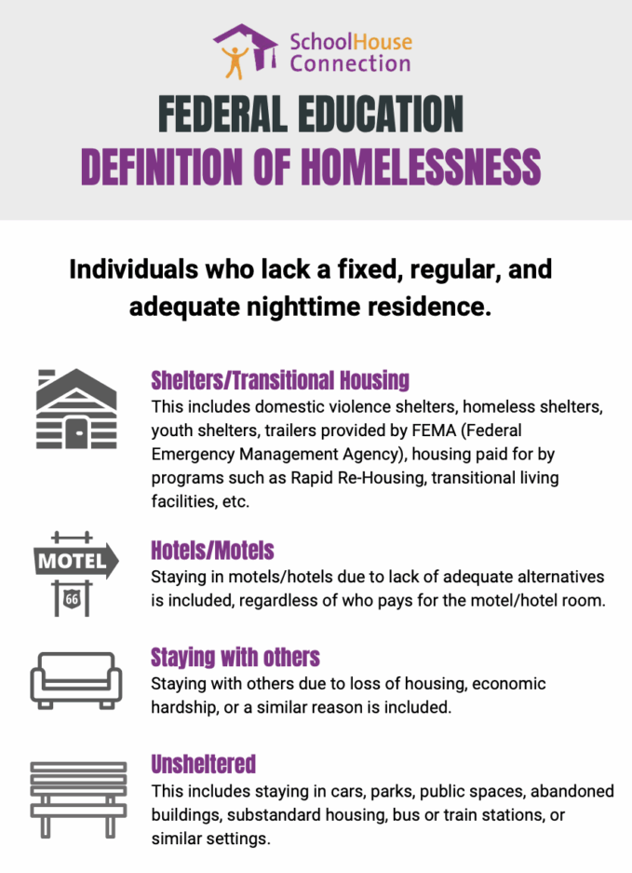

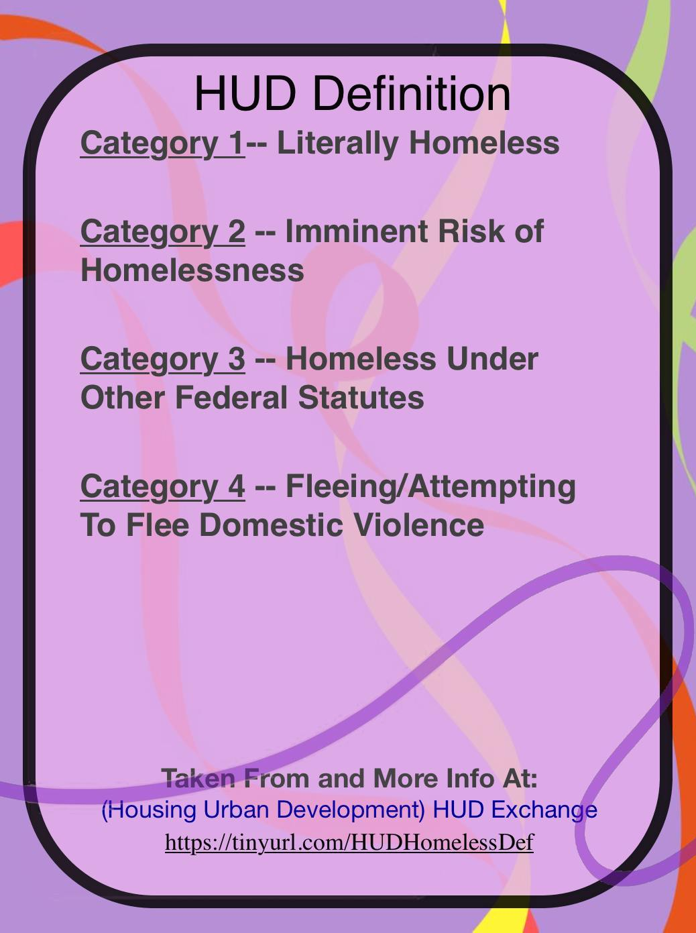
Two Federal Definitions of Homeless: McKinney-Vento & HUD
Notes:
Both are federal so both should be considered as equally valid.

Slide 8
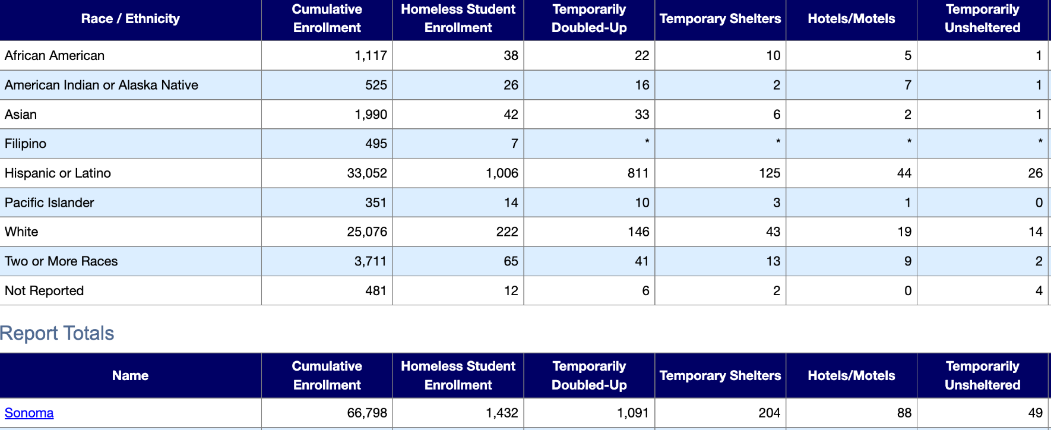

Students of color are disproportionately impacted by homelessness
Homeless Data 2024-2025
Notes:
Barriers to the services that cause the children to be on my caseload - racial justice - health crisis.
In Sonoma County, 81% of unhoused students are students of color

Slide 9
Challenges and Barriers
McKinney-Vento families & students were asked about challenges to attending school:
★ Family worried about basic survival needs ★ Lack of Transportation
★Inability to do homework due to lack of study area ★ Lack of Clothing & Supplies ★ Poor Health & Medical Care
“What were the major barriers you faced when attempting to enroll in school?”
62% of students said that proof of residency requirements posed a major challenge for them.
60% found changing schools difficult to navigate.
56% said lack of cooperation between their new school and old school posed a major challenge.
What are the impact on students going through this challenges:
3x the rate of emotional and/or behavioral problems than their peers.
Twice as likely to repeat a grade, be expelled or suspended
With each change in school, they are set back academically by an average of 4-6 months
87% increased likelihood of dropping out of school.
42% of children experiencing homelessness are under the age of six
Notes:
TO ANIMATE. In addition to those challenges that housing insecurities can bring, families & students faced other hurdles when attempting to enroll in school; such as providing proof of residency & medical records. You can see here how families & students responded when asked what were the major barriers they faced when enrolling in school. Negative past experiences in schools can also result in a reluctance to seek help in school

Slide 10
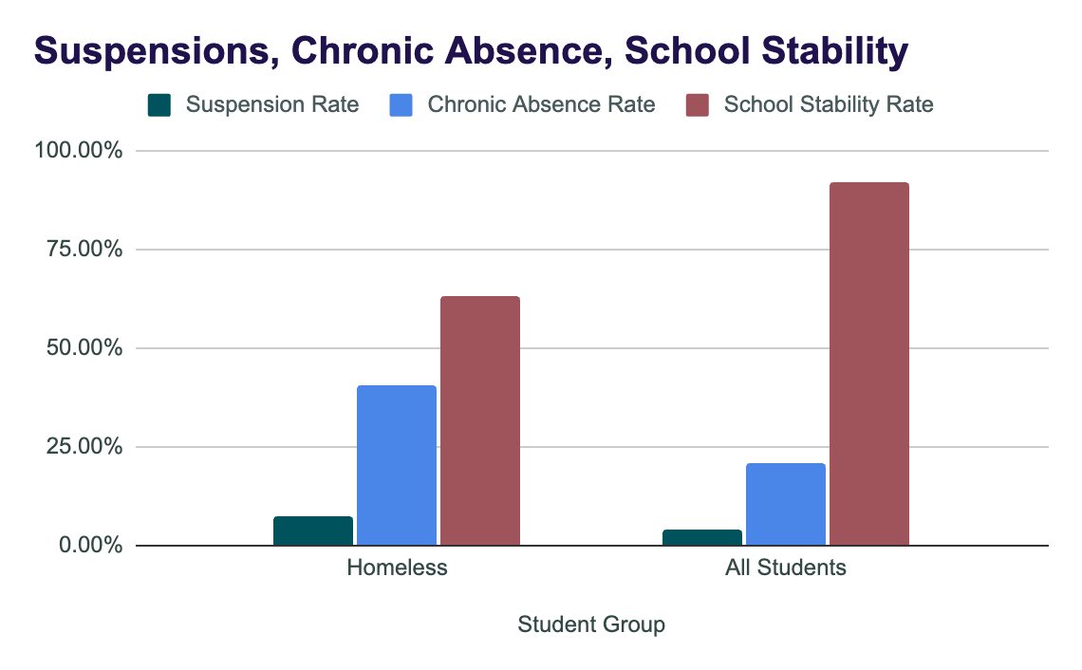
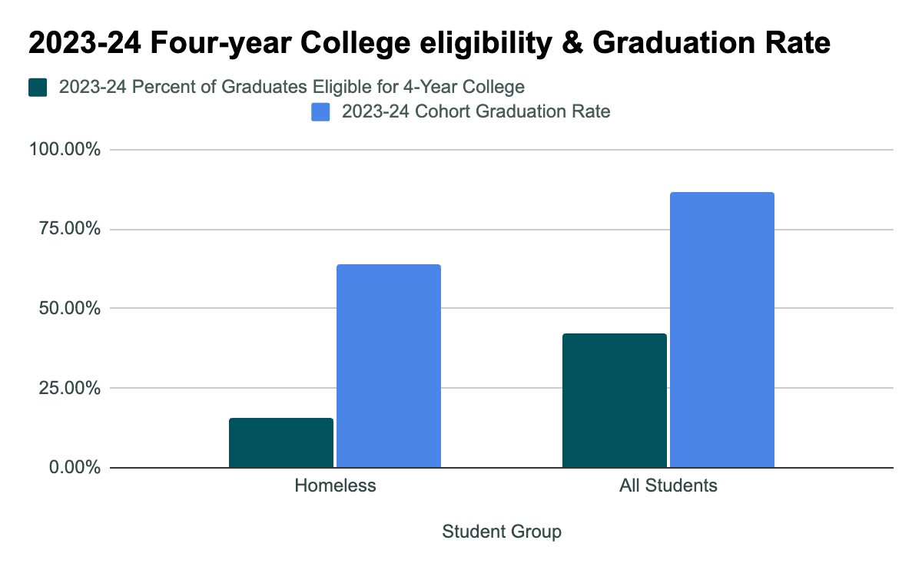

Academic performance for youth impacted by homelessness in Sonoma County

Slide 11
Recent Call for Action & Collaboration
The staff of Sonoma County Office of Education’s McKinney-Vento program provides school districts, families, and community partners with training, assistance, and resources to help meet students’ most basic educational needs, including backpacks, school supplies, and hygiene kits.
All of this is done to meet the needs of the 1,432 homeless students on a budget of just $79,000 a year. That adds up to approximately $55 per student per year, equating to less than $5.00/month. And all of this funding that SCOE gets is from a competitive grant.
McKinney-Vento is funded by the US Department of Education. The staff received additional funding during the pandemic, but those funds have expired. There has been a recent call for the State of California to match the federal funding received so that we can do more for our students.
The state has no dedicated funding for this student group.
While these students may benefit from initiatives that address the needs of socioeconomically disadvantaged students more broadly, students who are experiencing homelessness often have distinct and unique needs that are not addressed by broader reaching interventions.
With the continued fires in our state are poised to exacerbate the homelessness crisis, an investment of resources into meeting the needs of homeless students is more essential now than ever before.
How are your local resources being used to address students experiencing homelessness?
Notes:
Letter sent in January - use your platform to lobby relationships to fight for more funding.

Slide 12
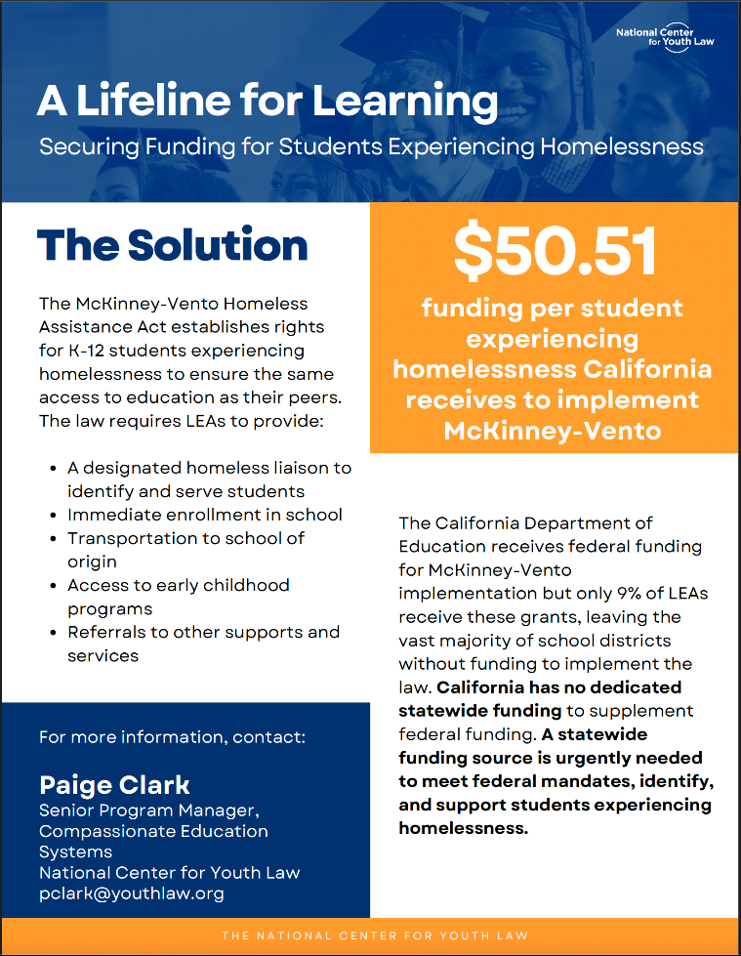
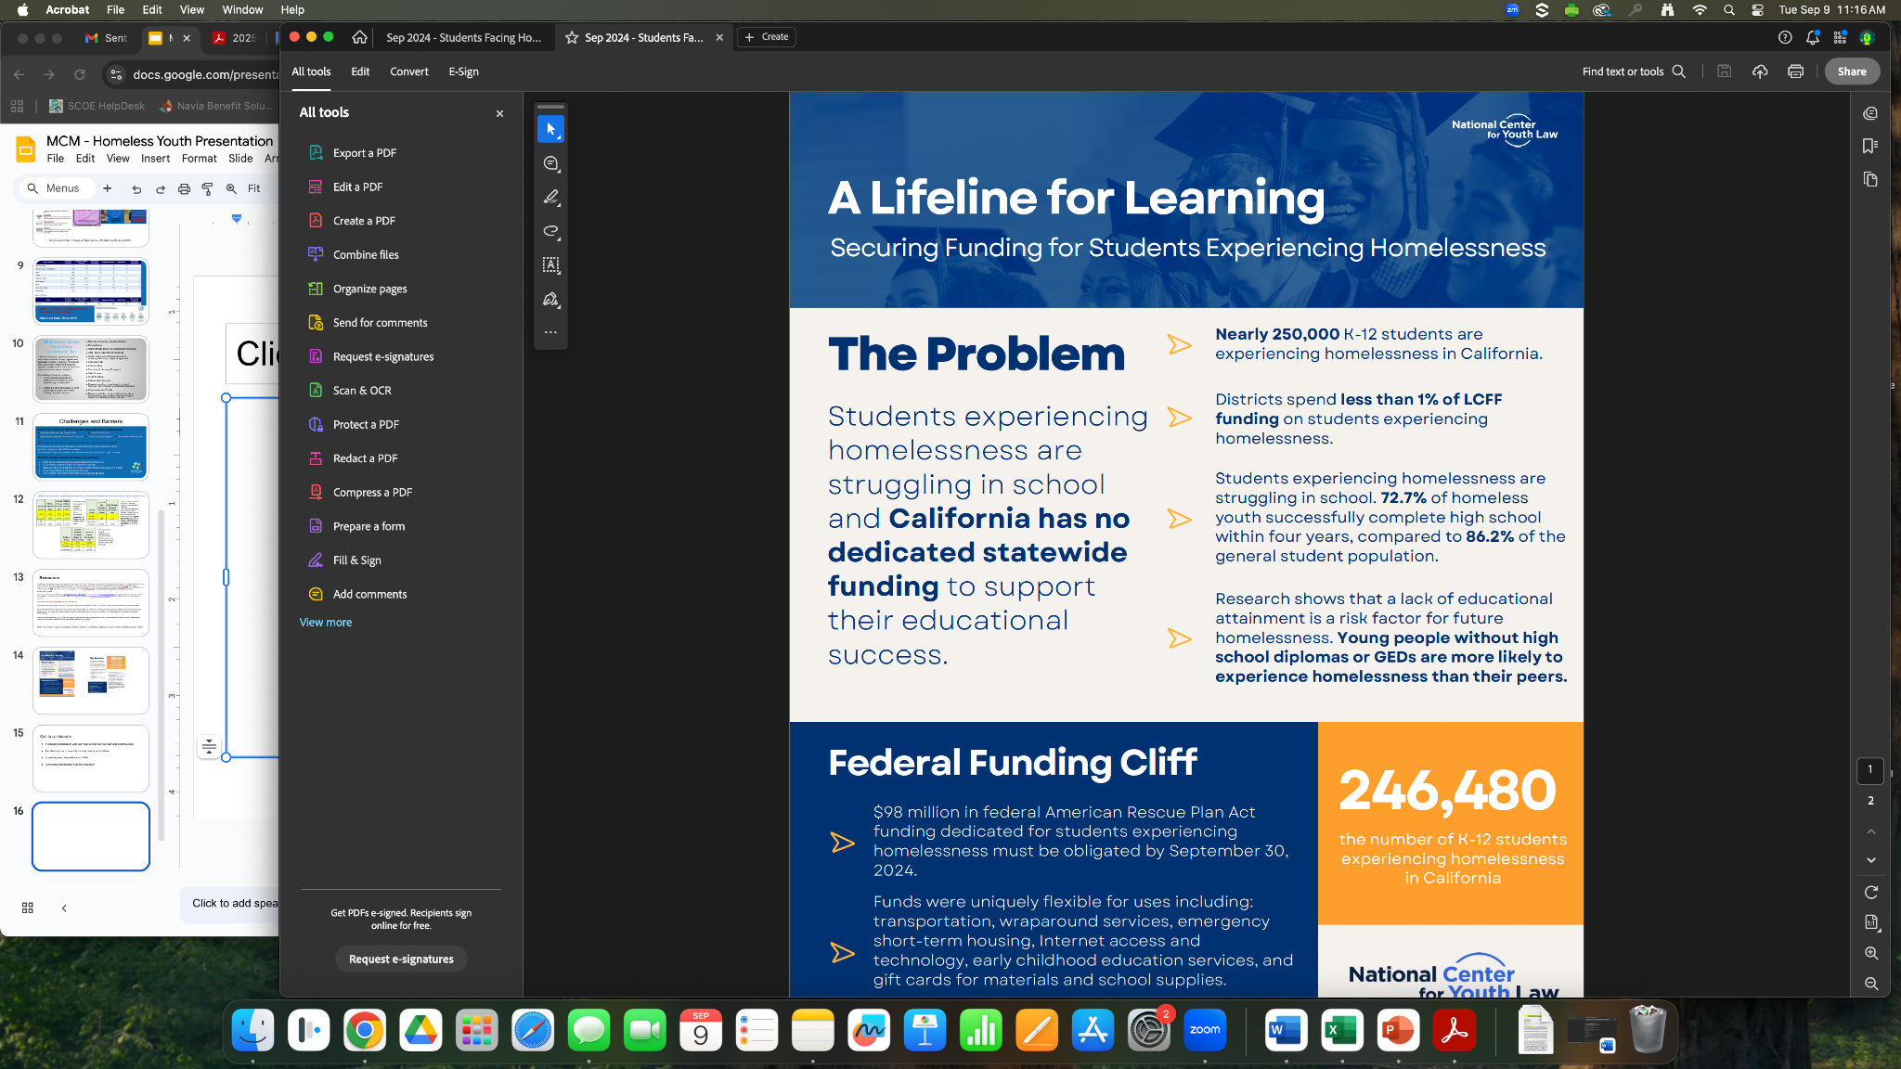
Recent Call for Action & Collaboration
Increased collaboration with your local school districts & PTA; staff and board trustees.
Members of your community include parents and children.
Leveraging relationships with SRJC & Sonoma State University

Slide 13
Evidence based solutions
Existing research points to three essential characteristics of interventions that have a measurable impact on student outcomes.
1. Robust protocols for identification of homeless students. Students experiencing homelessness cannot be served if they are not identified. High school students, particularly unaccompanied youth, are also less likely to self-identify as homeless.
2. Strong connections to supportive adults. An outcome report from a project in Monterey County that provided targeted one-on-one support to homeless students found that program participants achieved a graduation rate of 92.8 percent. Program participants saw similarly impressive gains to GPAs, attendance and school stability. Another study found that engagement in school activities and positive relationships with adults were linked to improved attendance and academic performance among homeless students, while students without these connections faced higher risks of absenteeism and disengagement.
3. A supportive school climate. A positive school climate, defined by researchers as a combination of the presence of social support at school, opportunities for belonging and connectedness, school safety, physical school resources and supportive discipline practices, can serve as a counterbalance to adverse childhood experiences.

