Slide 1

Mayors and Councilmembers’ Association of Sonoma County Board of Directors Meeting
Trish Pisenti
Deputy Director
Public Infrastructure
October 10, 2024

Slide 2
SPI/ZWS Infrastructure Projects
Central Landfill Expansion Project (SPI)
Meacham Road Mitigation Bank Project (SPI)
Airport Closed Landfill Compost Project (SPI/ZWS)
New Household Hazardous Waste Facility (ZWS/SPI)

Slide 3
Central Landfill Expansion Background
Sonoma County Central Disposal Site (CDS) started operation in 1972
Valuable asset providing daily disposal needs
Critical resource for disposal after natural disasters
Estimated remaining CDS lifespan of 15 years per state-required calculations
Closure of CDS will trigger economic & environmental impacts

Slide 4
Regional Capacity Study
Wildfires since 2017 have impacted the capacity of the CDS and regional landfills in the Bay Area
Natural disasters are now part of strategic waste planning
November 2022: Regional Capacity Study Performed – Recommendation to expand landfill
The study examined potential alternatives to address future solid waste needs, including outhaul or expansion of the CDS

Slide 5
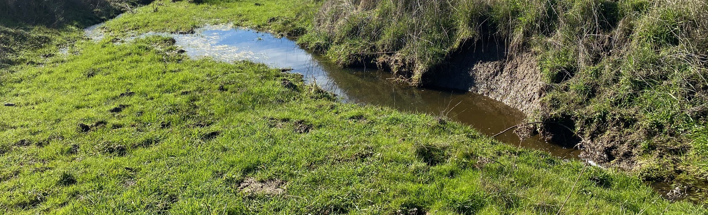
What is a Mitigation Bank?
  Definition:
  A mitigation bank is a wetland, stream, or aquatic resource area preserved, enhanced, restored, or established to compensate for unavoidable future impacts to aquatic resources.

Slide 6
Mitigation Bank Project Background
Projects with wetland, stream, habitat or species impacts require the following mitigation steps:
  Avoid Environmental Impacts
  Minimize Environmental Impacts
  Compensatory mitigation to offset unavoidable adverse impacts which remain after avoidance and minimization has been achieved.

Slide 7
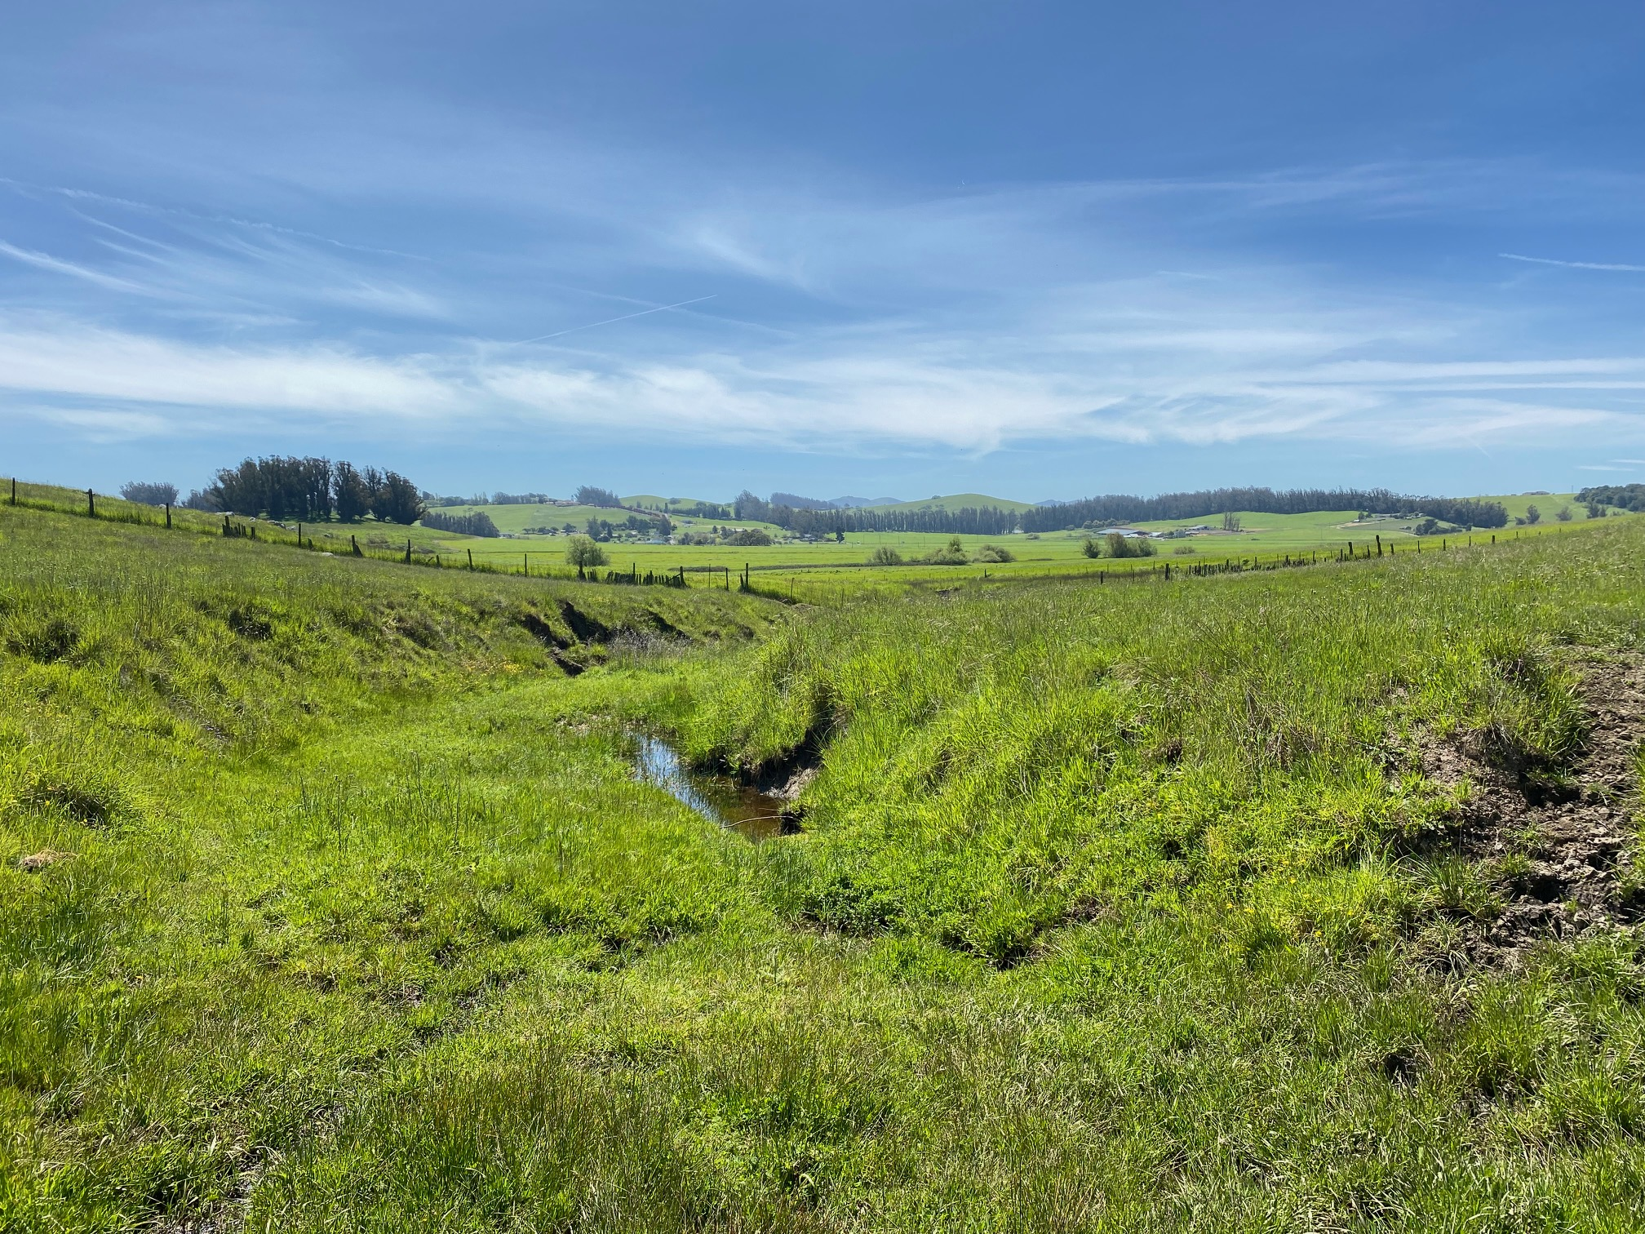
Mecham Road Mitigation Bank Credit Potential
Wetland, Riparian, Intermittent Stream
  4.11 acres
California Tiger Salamander
  124.65 acres
California Red-Legged Frog
  124.65 acres

Slide 8
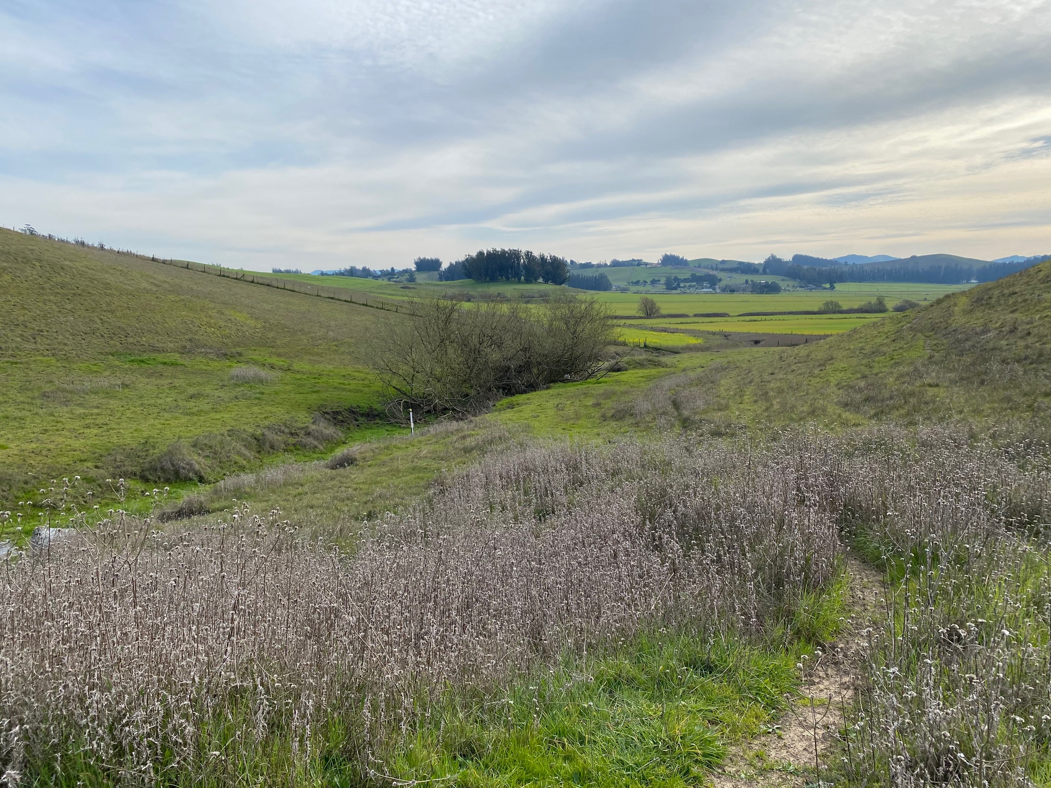
Benefits
Balancing Act: Addresses the needs of both development and environmental conservation.
Mitigation Credits: Secure on-demand credits for projects.
Economic Development: Facilitate projects, long-term cost savings, and saved project time.

Slide 9
Household Hazardous Waste Funding
Sonoma County Public Infrastructure (SPI) is collaborating with Zero Waste Sonoma (ZWS) to construct a new HHW facility in Northern Sonoma County.
Project Cost: Estimated at $12 million
Line of Credit: SPI proposes up to $12 million from the County's Contingent Liability Reserve Fund to fund the project
Landfill Settlement Agreement Amendment: The County needs to amend the Landfill Settlement Agreement to allocate funds for this project, which will require city support ensuring this project moves forward to benefit all stakeholders.
The Landfill Settlement Agreement is an agreement between Sonoma County and the committed cities that governs landfill liabilities and funding. Amending it allows SPI and ZWS to secure preferred funding vs private markets for the HHW facility

Slide 10



ZWS Training 101
Mayors and Councilmembers’ association of Sonoma county board of directors Meeting
September 25, 2019
Leslie Lukacs
Executive director zero waste Sonoma
October 10, 2024

Slide 11
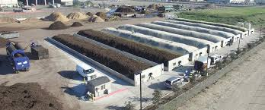
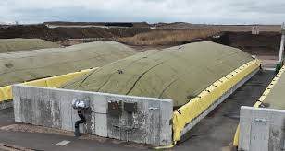
Proposed Organics Processing project
Airport property west of the runway
Closed landfill with no existing infrastructure utilities on the property
Feasibility study completed December 2022
Consulting firm completing 30% Design, Public Outreach and CEQA Studies
Covered aerated static pile (ASP) system
20 bunkers of the SG/Gore ASP system
Process70 ,000 tons of new residential organic annually

Slide 12
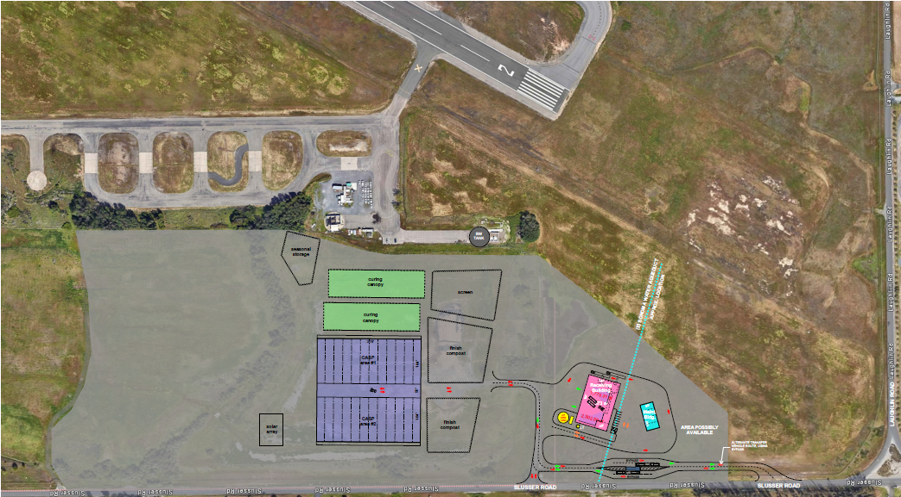
Compost site

Slide 13
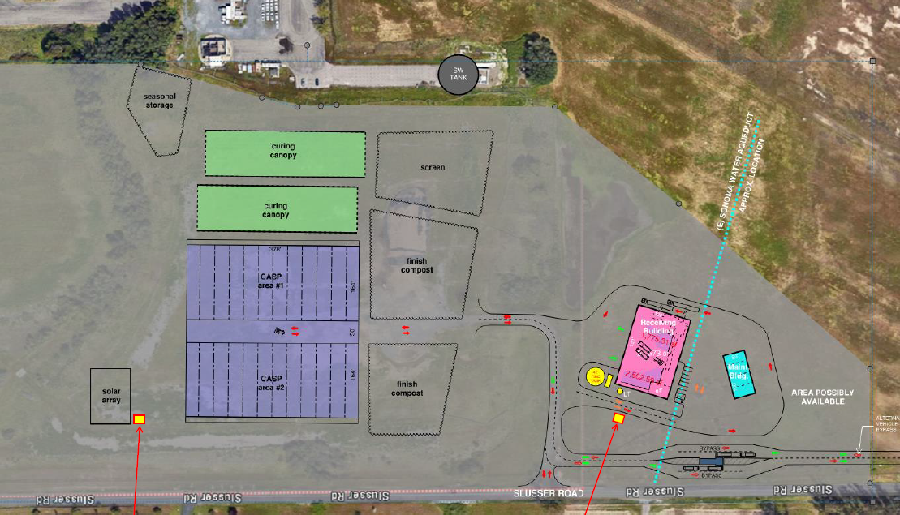

Slide 14
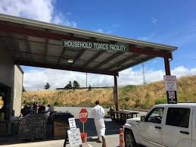
Land Purchase for HHw facility
HHW program expansion analysis in 2018
Purchased 3.5-acre property on Pruitt Ave in Windsor
Construct 10,000 SF building and ZWS offices
SPI provides assistance with the project management, procurement of consultants for the design
Solicited proposals for architectural and engineering design services

Slide 15
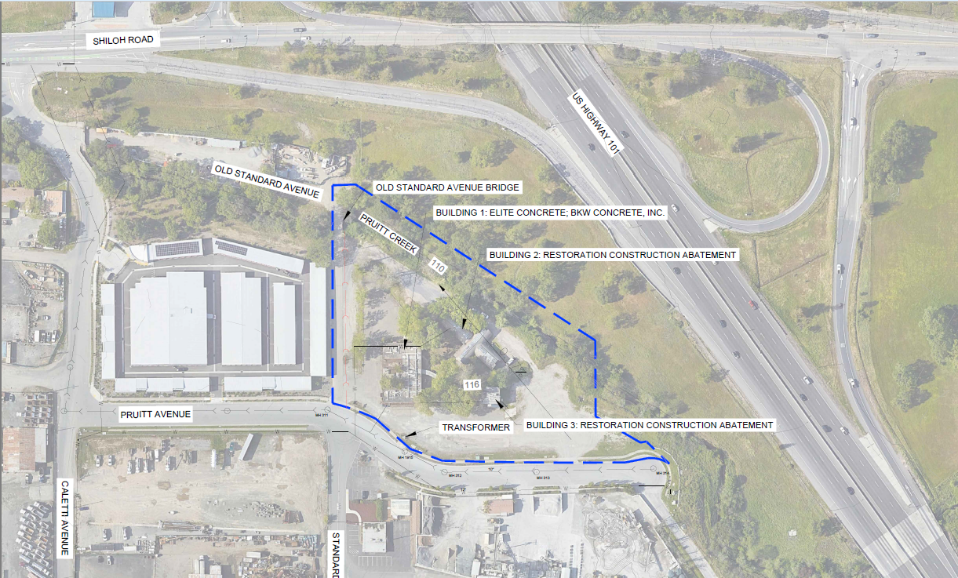

Slide 16
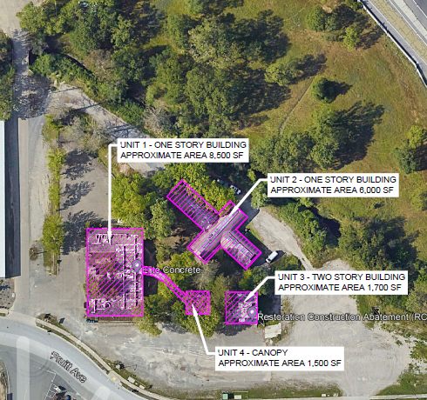

Slide 17
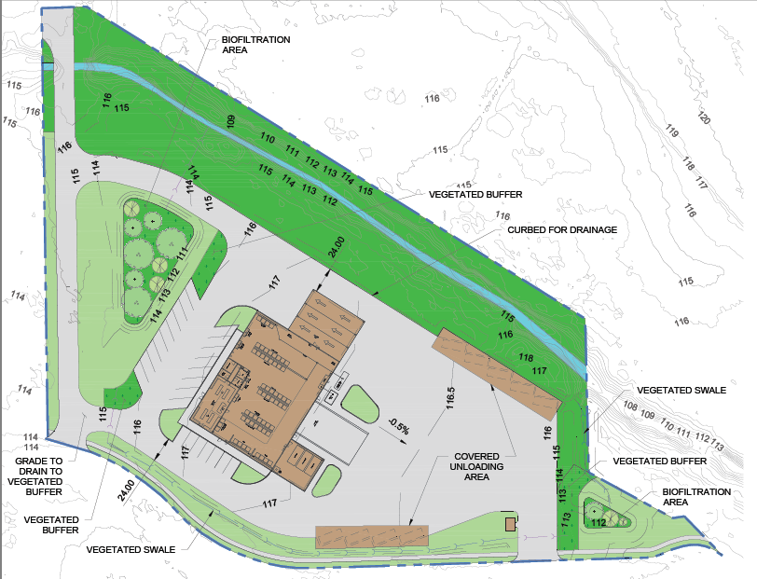

Slide 18
