Slide 1
Board of Directors Meeting
July 11, 2024
MAYORS’ & COUNCILMEMBERS’ ASSOCIATION OF SONOMA COUNTY

Slide 2

State Ballot: November 2024
Prop 2: Education Facilities Bond: $10 billion in bond financing for aging educational facilities. $8.5 billion would go toward updating or building new K-12 buildings. The remaining $1.5 billion would be used for community colleges.
Prop 3: Marriage Equality: This ballot measure would eliminate outdated language from California’s Constitution (Prop. 8 2008) that says marriage is a union between one man and one woman.
*Prop 4: Climate Bond: $10 billion in bond funds for a variety of climate projects.
*Prop 5: Local Government Funding: Would allow a city, county, or special district, with 55% voter approval, to incur bonded indebtedness to fund projects for affordable housing, permanent supportive housing, or public infrastructure.
Prop 6: Slavery: Would ban involuntary servitude, which would end forced labor in state prisons.

Slide 3
State Ballot: November 2024
Prop 32: Minimum Wage: Would increase California’s minimum wage to $18 an hour over the next couple years. If it passes, all minimum wage workers who earn $16 an hour right now, would see their pay gradually increased by a dollar each year until it reaches $18 on January 1, 2026.
*Prop 33: Rent Control: Would end three decade-old law, known as the Costa-Hawkins Rental Housing Act, that bans rent control on single-family homes finished after February 1, 1995.
Prop 34: Patient Care: Would require certain organizations that use a federal drug discount program to spend at least 98% of those funds on direct patient care.
Prop 35: Medi-Cal Funding: Would make permanent a tax on health insurers, also known as the MCO tax, which is currently set to expire in 2026.
*Prop 36: Criminal Penalties: Would revise Prop 47 (2014 successful ballot initiative)

Slide 4
Notably NOT on the November 2024 Ballot
California Business Roundtable Measure removed by the California State Supreme Court – unanimous decision.
ACA 13 (Ward) : Measure to make it harder to raise voter threshold on state ballot measures now November 3, 2026

Slide 5
Prop 36: Homelessness, Drug Addiction, and Theft Reduction Act
Proposition 47, which passed in 2014, reduced certain theft and drug crimes from felonies to misdemeanors.
Would change a third offense of theft to a felony punishable by up to three years in prison.
The measure also would make possession of fentanyl a felony.
Would impose "treatment-mandated felony” for the third time someone is arrested for drug possession.

Slide 6
Prop 33: Expands Local Governments’ Authority to Enact Rent Control on Residential Property
The “Justice for Renters Act” would repeal the Costa-Hawkins Rental Housing Act which limits local governments’ authority to enact rent control.
This measure also specifies the state may not limit the right of cities and counties to maintain, enact, or expand rent control.

Slide 7
Prop 5: Local Government Financing for Affordable Housing and Public Infrastructure
Placed on Ballot via ACA 1 & ACA 10 (Aguiar-Curry)
Would allow a city, county, or special district, with 55% voter approval, to incur bonded indebtedness to fund projects for affordable housing, permanent supportive housing, or public infrastructure.

Slide 8
Prop 4: Safe Drinking Water, Wildfire Prevention, Drought Preparedness, and Clean Air Bond
$10 Billion Bond Allocates:
  $3.8 billion for safe drinking water, drought, flood, and water resilience programs
  $1.5 billion for wildfire and forest resilience programs
  $1.2 billion to protect coastal lands, waters, communities, natural resources, and urban water fronts from sea level rise and other climate impacts
  $1.2 billion to protect California's biodiversity and implement nature-based climate solutions
  $850 million for clean energy projects
  $700 million for the creation of parks and outdoor access
  $450 million to address extreme heat and extreme heat events in communities
  $300 million to improve climate resilience and sustainability of agricultural lands

Slide 9
The rest of 2024….
August 5: Legislature reconvenes
August 31: Legislature adjourns
September 30: Governor deadline to sign/veto
October 7: County Elections Offices mail Ballots/Voting begins
November 5: Election Day

Slide 10
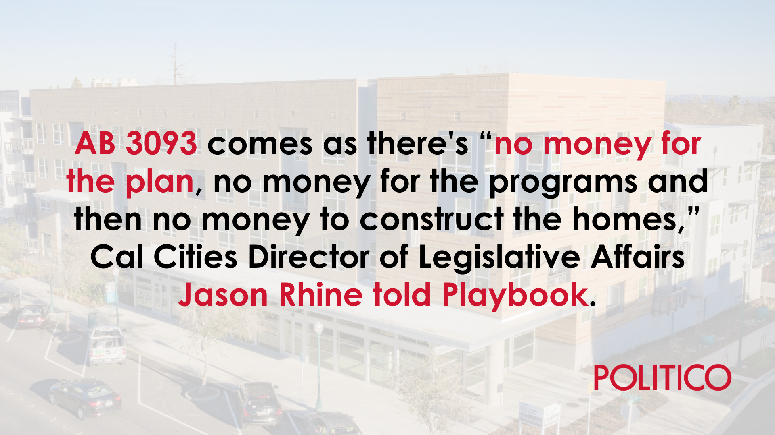
Housing for homeless residents
AB 3093 (Ward) Land Use: Housing Element: Streamlined Multifamily Housing.
This measure would require local governments to account for the housing needs of people experiencing homelessness in their housing elements by adding two new income categories to the Regional Housing Needs Assessment framework: acutely low-income and extremely low-income.
Cal Cities Position: Oppose Unless Amended

Slide 11
Labor relations
AB 2557 (Ortega) Local Agencies: Contracts for Special Services and Temporary Help: Performance Reports.
This measure would burden the process for cities, counties, special districts, and schools to contract out for statutorily authorized special services by requiring onerous contractor reporting obligations, and by exposing contractors’ employee data. This measure would likely disincentivize contractors from doing business with affected local agencies and increase costs and delays.
Cal Cities Position: Oppose

Slide 12
Labor relations
AB 2561 (McKinnor) Local Public Employees: Vacant Positions.
This measure would require local agencies with bargaining unit vacancy rates exceeding 15% for more than 180 days to produce, implement, and publish a plan to reduce their vacancy rates to 0% within the subsequent 180 days. This measure would also require the public agency to present this plan during a public hearing to the governing legislative body.
Cal Cities Position: Oppose

Slide 13
Levine Act
SB 1243 (Dodd) Campaign Contributions: Agency Officers.
This measure would raise the threshold for contributions permitted by the Levine Act from $250 to $1,000. It would also extend the time period to cure a violation after a final decision from within 14
days to within 30 days.
Cal Cities Position: Support

Slide 14
Housing element
SB 1037 (Wiener) Planning and Zoning: Housing Element: Enforcement.
This measure would fine jurisdictions up to $50K a month for either not having a compliant housing element or for disregarding any state law regarding the ministerial approval process of an affordable housing project even if the jurisdiction is acting in good faith. This measure does not provide an opportunity to cure the violation before fines are imposed.
Cal Cities Position: Oppose

Slide 15
Builders Remedy
AB 1886 (Alvarez) Housing Element Law: Substantial Compliance: Housing Accountability Act.
This measure would allow the Builder’s Remedy to begin as soon as the Department of Housing and Community Development or a court determines a jurisdiction’s housing element is out of compliance and past the due date.
Cal Cities Position: Oppose
AB 1893 (Wicks) Housing Accountability Act: Housing Disapprovals: Required Local Findings.
This measure would allow the Builder’s Remedy to kick in if a local jurisdiction is not in compliance with Housing Element Law and a proposed development project provides a minimum number of units for specific income levels. This measure would limit the Builder’s Remedy to areas zoned for residential, retail, office, or parking are permissible uses and sets a cap on maximum density.
Cal Cities Position: Oppose Unless Amended

Slide 16
Development fees
SB 937 (Wiener) Development Projects: Permits and Other Entitlements: Fees and Charges.
This measure would limit the ability of local governments to collect mitigation fees on affordable housing projects when either a certificate of occupancy is issued, or once construction commences for the projects the fees will be used for.
Cal Cities Position: Oppose Unless Amended

Slide 17
Retail Theft Legislative Package
Assembly Bills
Senate Bills
AB 1779 (Irwin)
AB 1802 (Jones-Sawyer)
AB 1960 (Rivas)
AB 1972 (Alanis)*
AB 2943 (Zbur)
AB 3209 (Berman)
*Urgency Clause
SB 905 (Wiener)
SB 982 (Wahab)
SB 1144 (Skinner)
SB 1242 (Min)
SB 1416 (Newman)

Slide 18
Property taxes
AB 2564 (Boerner) Property Tax Postponement: Senior Citizens and Disabled Citizens Property Tax Postponement Fund.
This measure would reinstate General Fund support for the Senior Citizens and Disabled Citizens Property Tax Postponement Program.
Cal Cities Position: Support

Slide 19
Transportation
AB 2286 (Aguiar-Curry) Autonomous Vehicles.
This measure would prohibit the operation of an autonomous vehicle with a gross vehicle weight of 10,001 pounds or more without a human safety operator physically present in the autonomous vehicle at the time of operation.
Cal Cities Position: Support

Slide 20





REGISTER NOW
CONFERENCE AND EXPO
LONG BEACH, CA
OCTOBER 16-18, 2024

Slide 21
Questions & Thank you

